Slide 1

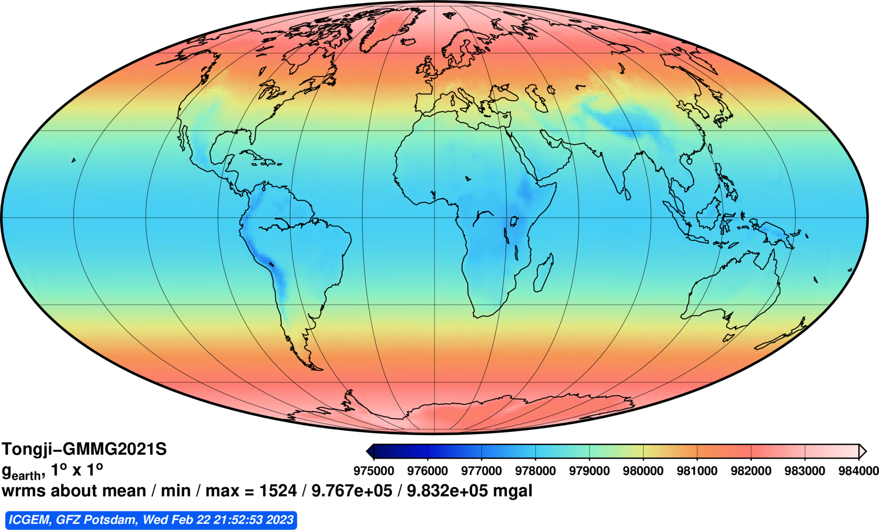
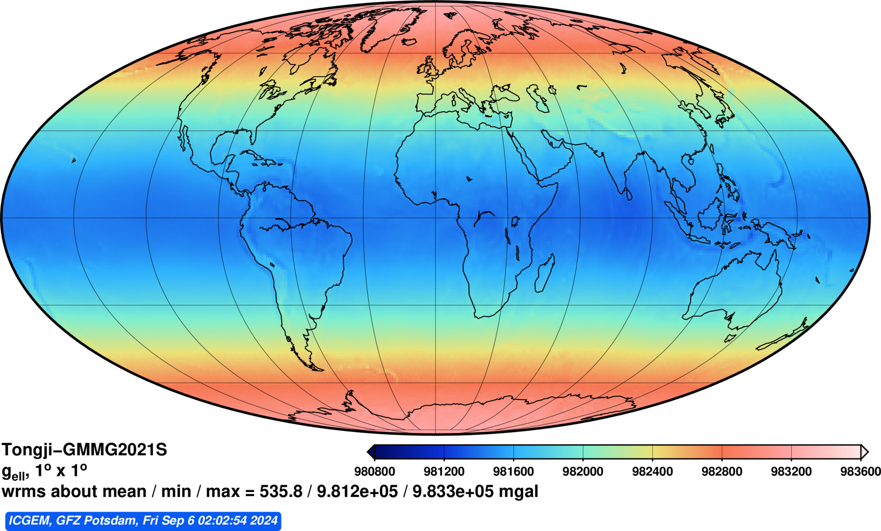
Earth Gravity field
The solid-earth is not homogenous
Earth Gravity at surface topography
Earth Gravity at ellipsoid
Do you notice the difference between these two maps?
What controls the gravity we see?

Slide 2
Earth Gravity field
The solid-earth is not homogenous
Earth Gravity at surface topography
Earth Gravity at ellipsoid
Do you notice the difference between these two maps?
What controls the gravity we see?

Slide 3
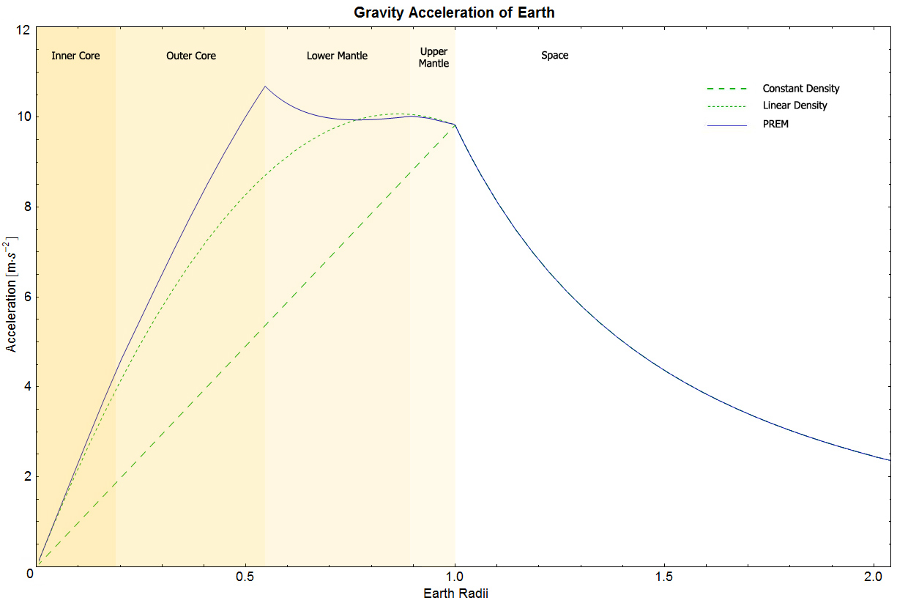
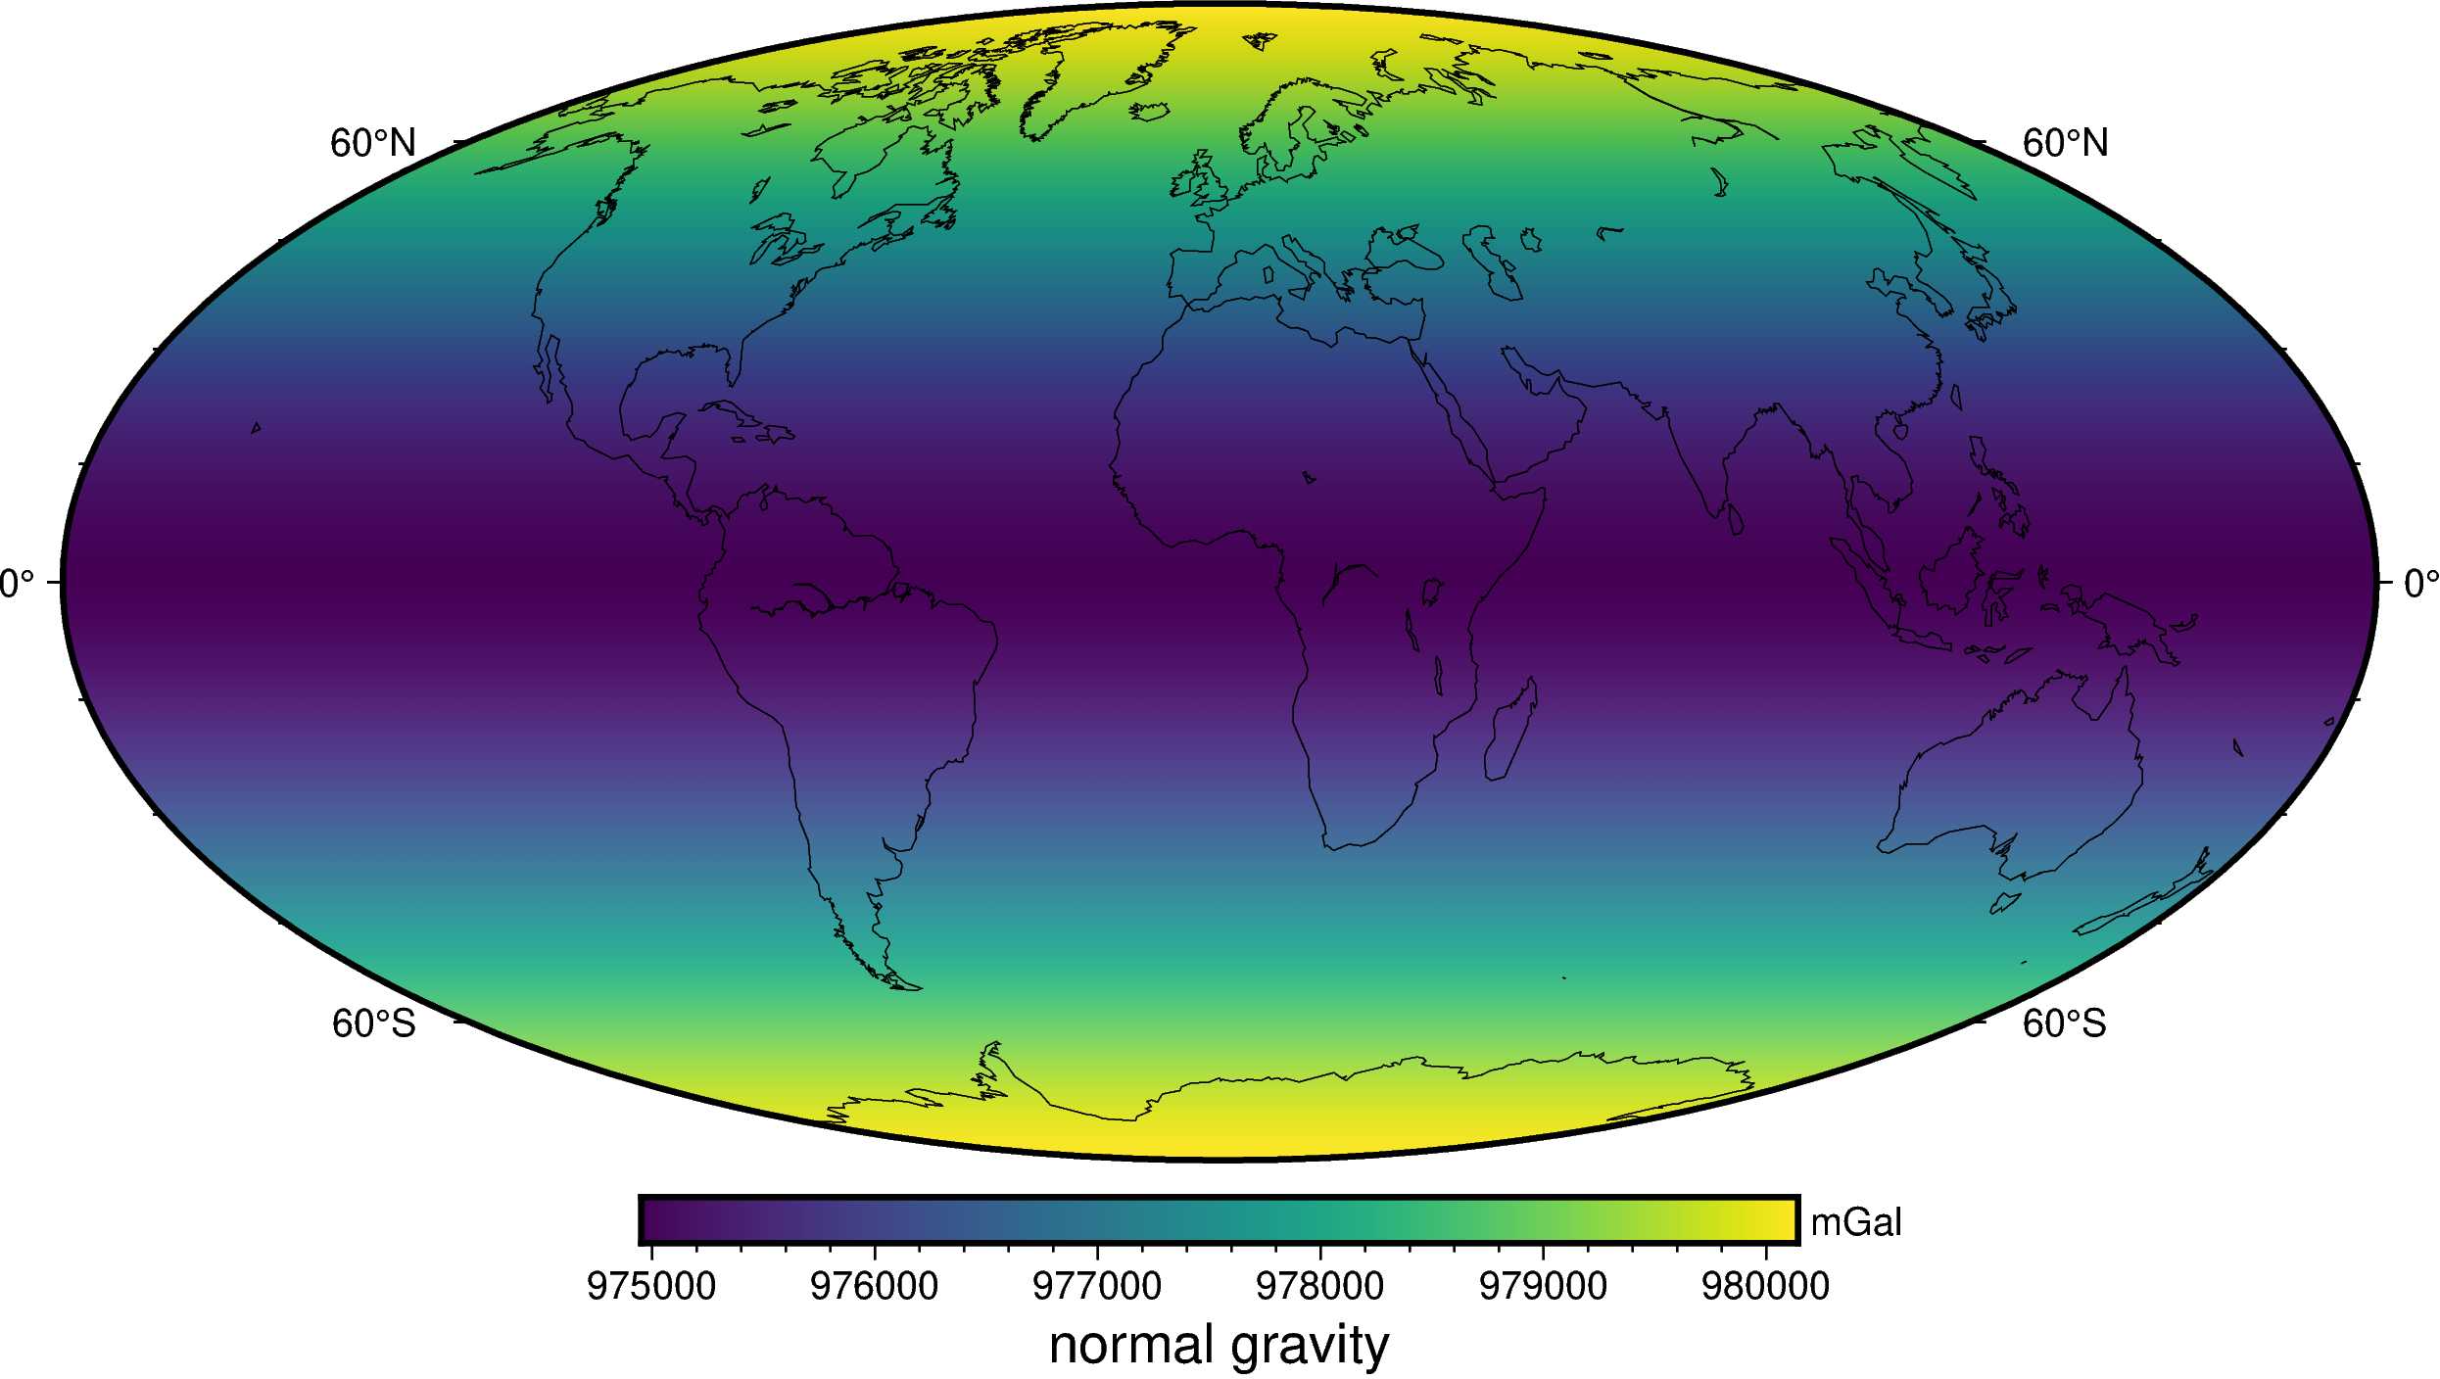
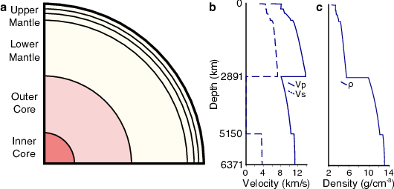
Reference Earth Model
1 D reference earth model and normal gravity
WGS84 normal gravity at ellipsoid
https://seismo.berkeley.edu/wiki_cider/images/3/34/Fig1_Ref_Mod_Earth_PREM.png

Slide 4
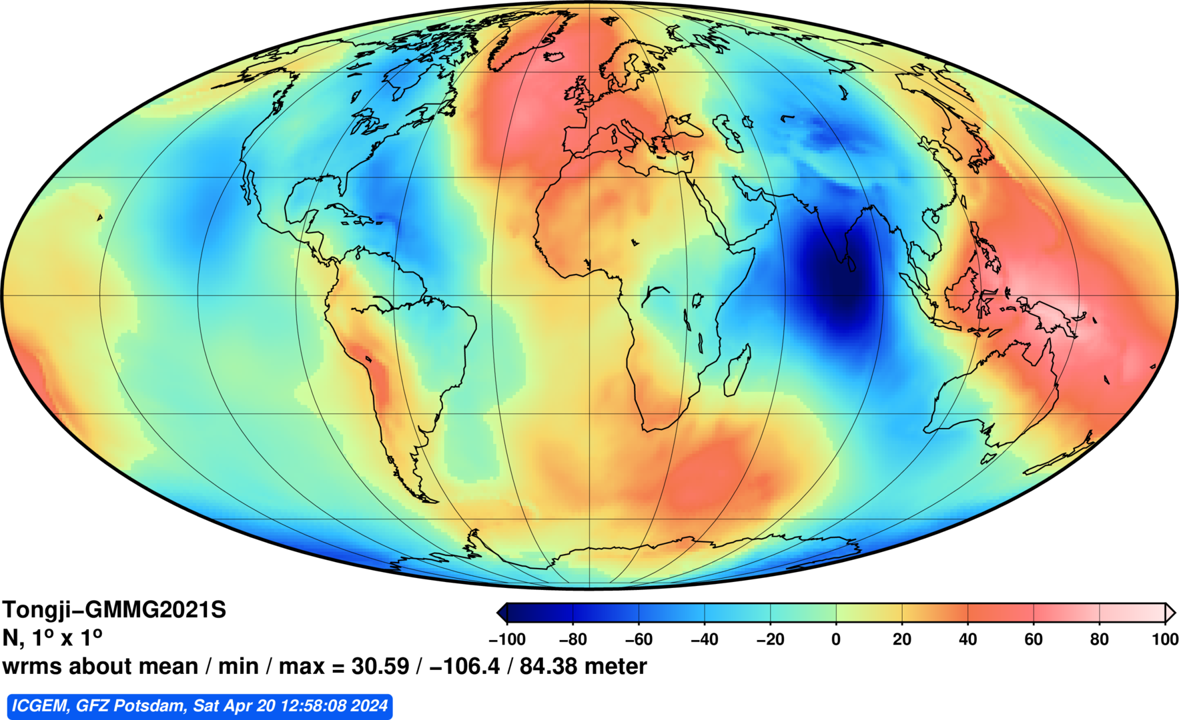
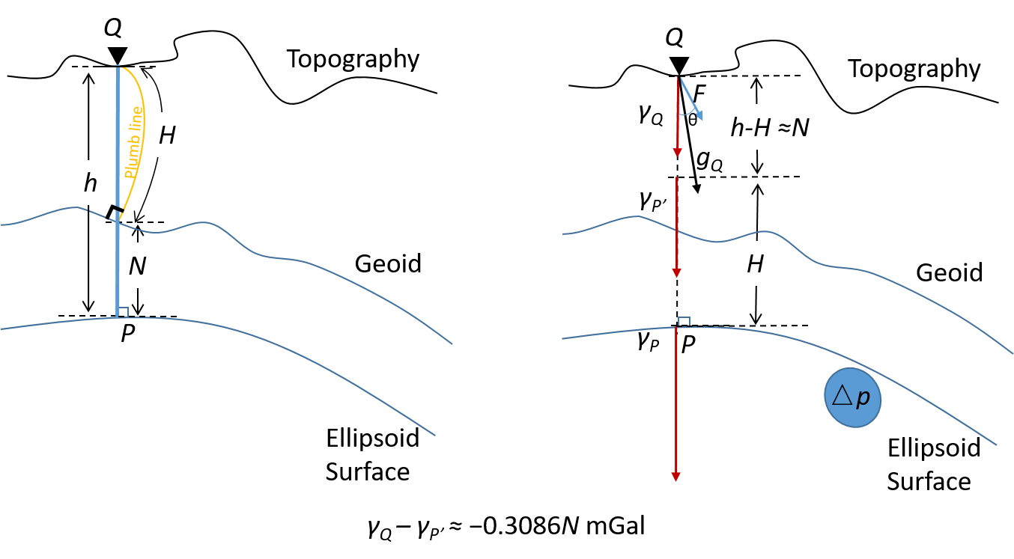
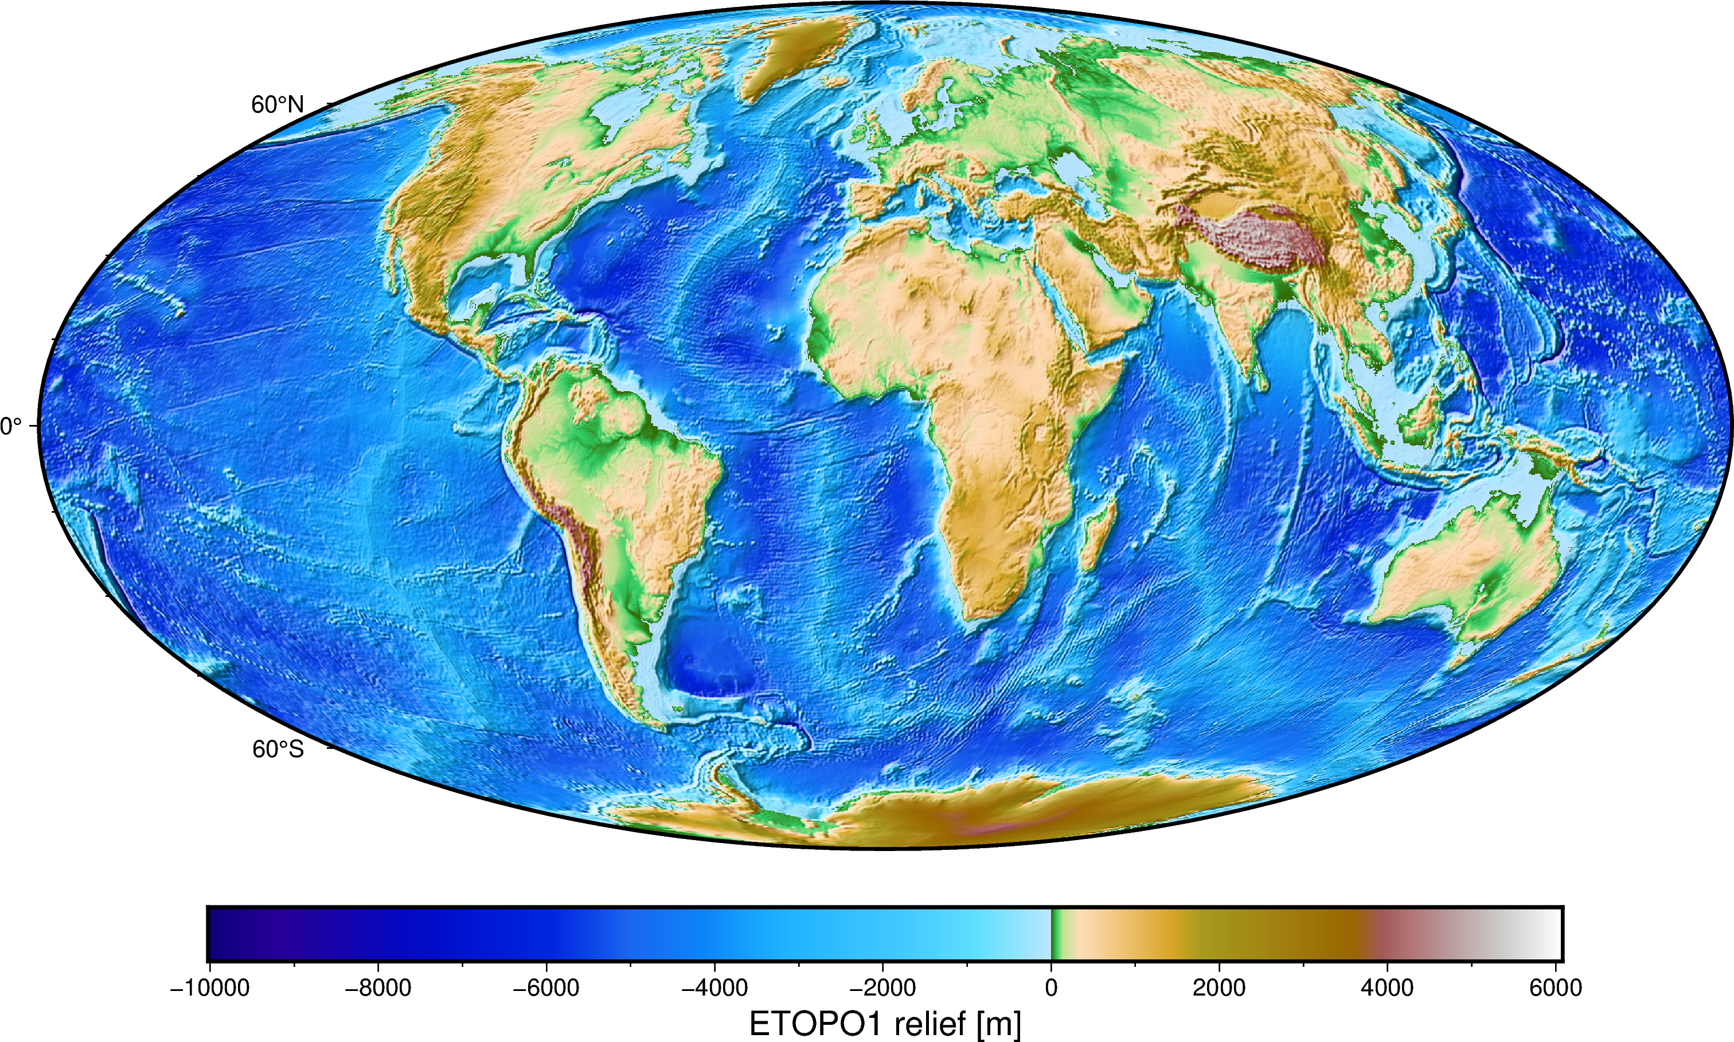
Reference Earth Model
Geoid and Ellipsoid
Geoids represent a hypothetical global sea level as it would be shaped by gravity if oceans could flow unobstructed though land.
AKA: mean sea-level
Geoid (relative to ellipsoid, WGS84)

Slide 5
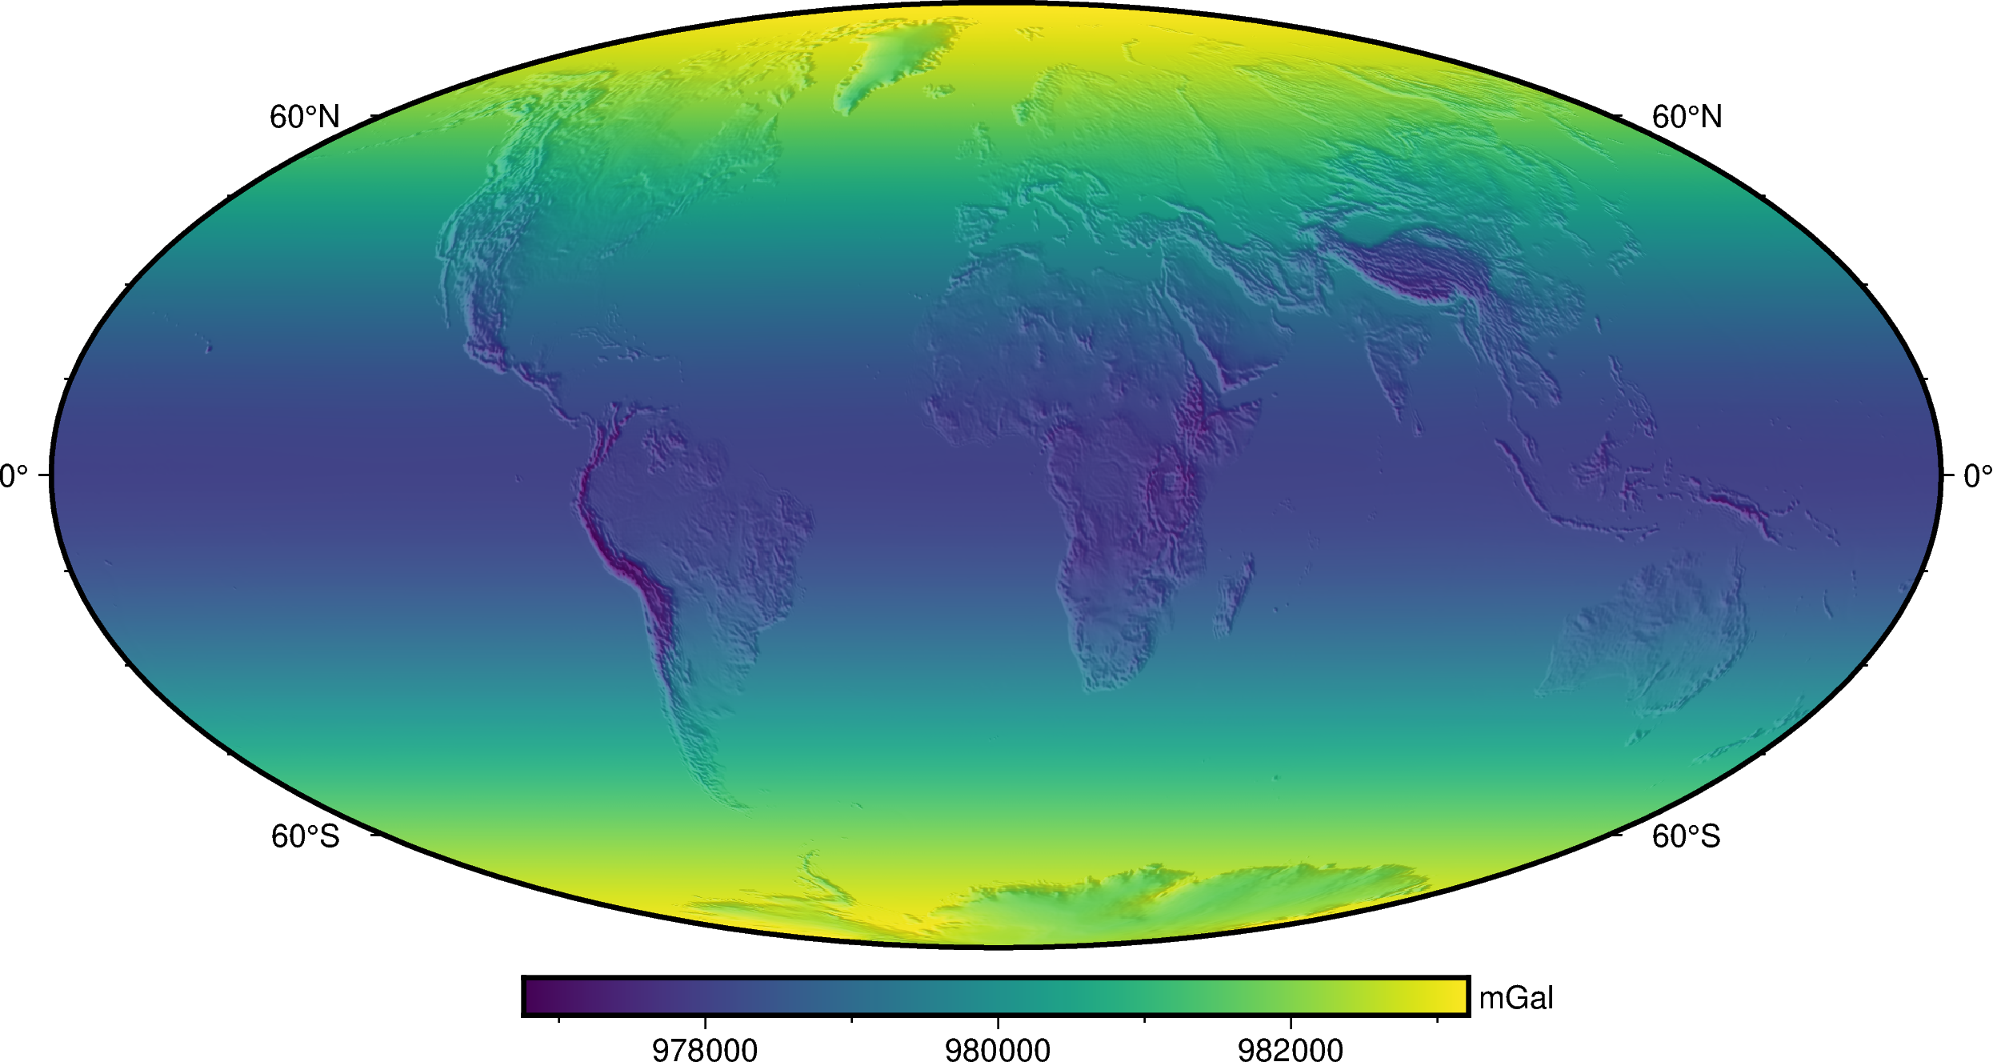
Reference Earth Model
The impact of observational height
WGS84 normal gravity at earth surface
WGS84 normal gravity at ellipsoid

Slide 6
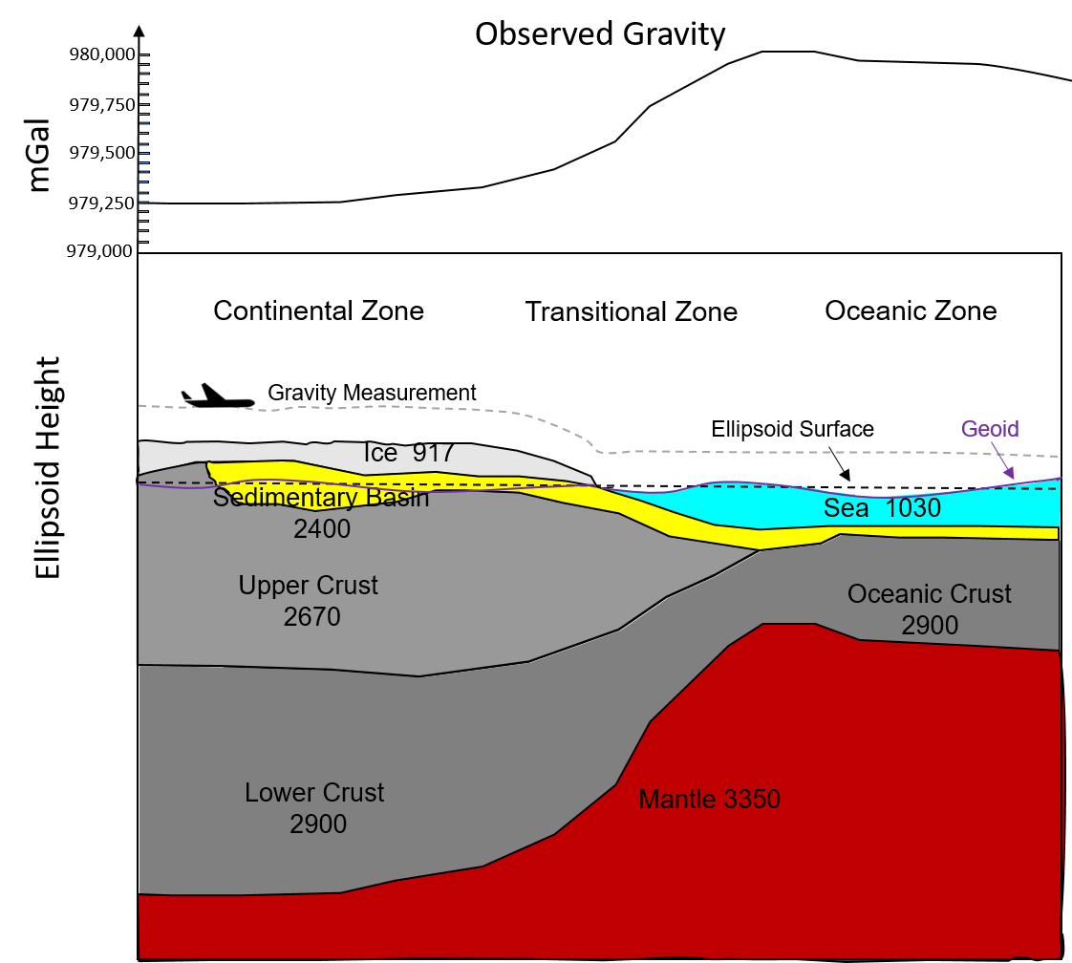
Geological properties and gravity
The solid-earth is not homogenous
Sedimentary Rocks
• Compaction – increases density by reducing pore-spaces
• Cementation – increase density by infilling pore-spaces
• Fluid-flux – replacing fluid with a different density can track fluid flux (e.g. injecting CO2 into a brine aquifer)
• Changes in depositional environment – e.g. shale vs sandstone
• Metamorphism
Crust – Bulk chemistry
Bulk chemistry (mafic vs intermediate vs felsic)
Alteration
Temperature
Mantle thermal expansion and Bulk chemistry
What controls the density?

Slide 7
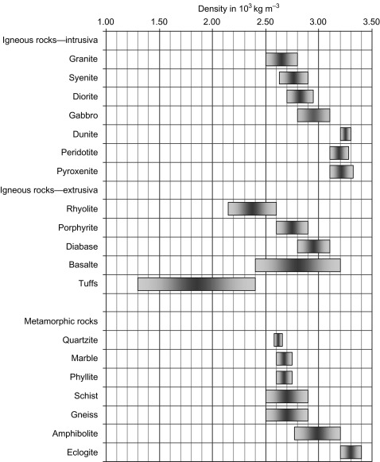
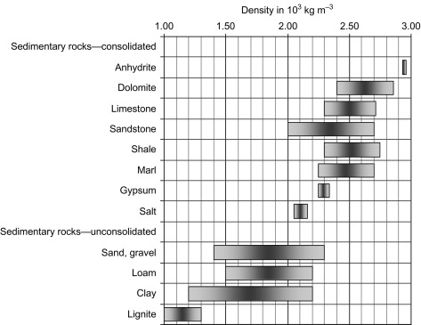
Geological properties and gravity
Schön 2015

Slide 8
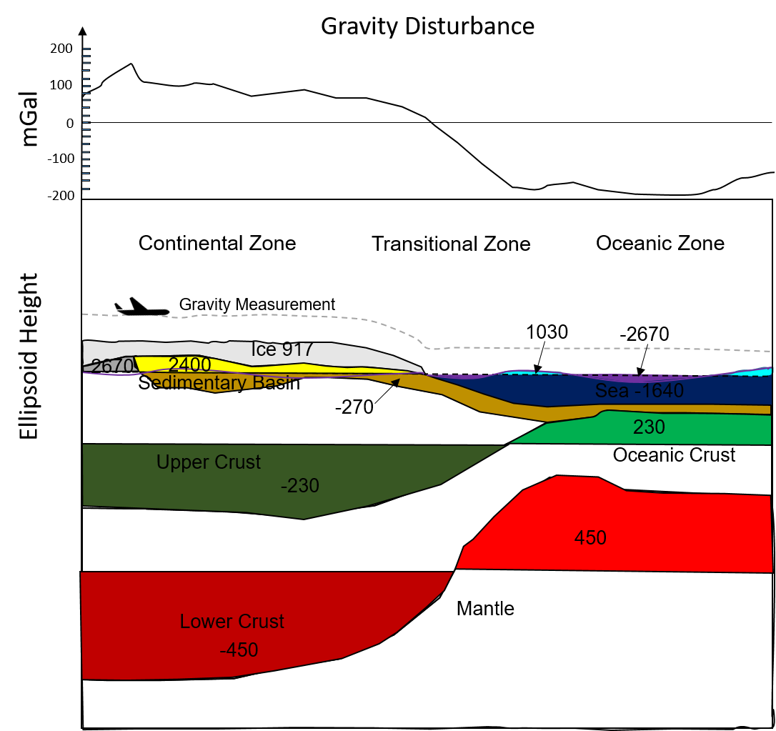
Geological properties and gravity
Earth Gravity field
=
Normal gravity (latitude variation + height variation)
+
Density variation due to geology

Slide 9
Geological properties and gravity
Free-Air Disturbance
What controls the density?

Slide 10
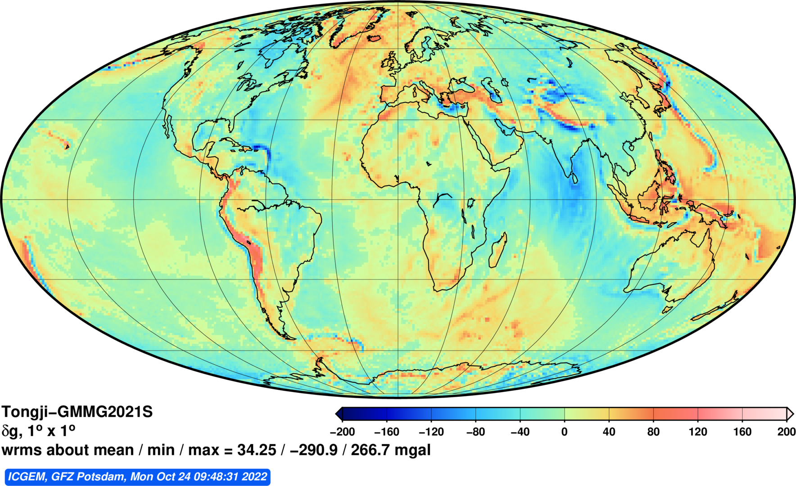
Geological properties and gravity
Free-Air Disturbance

Slide 11
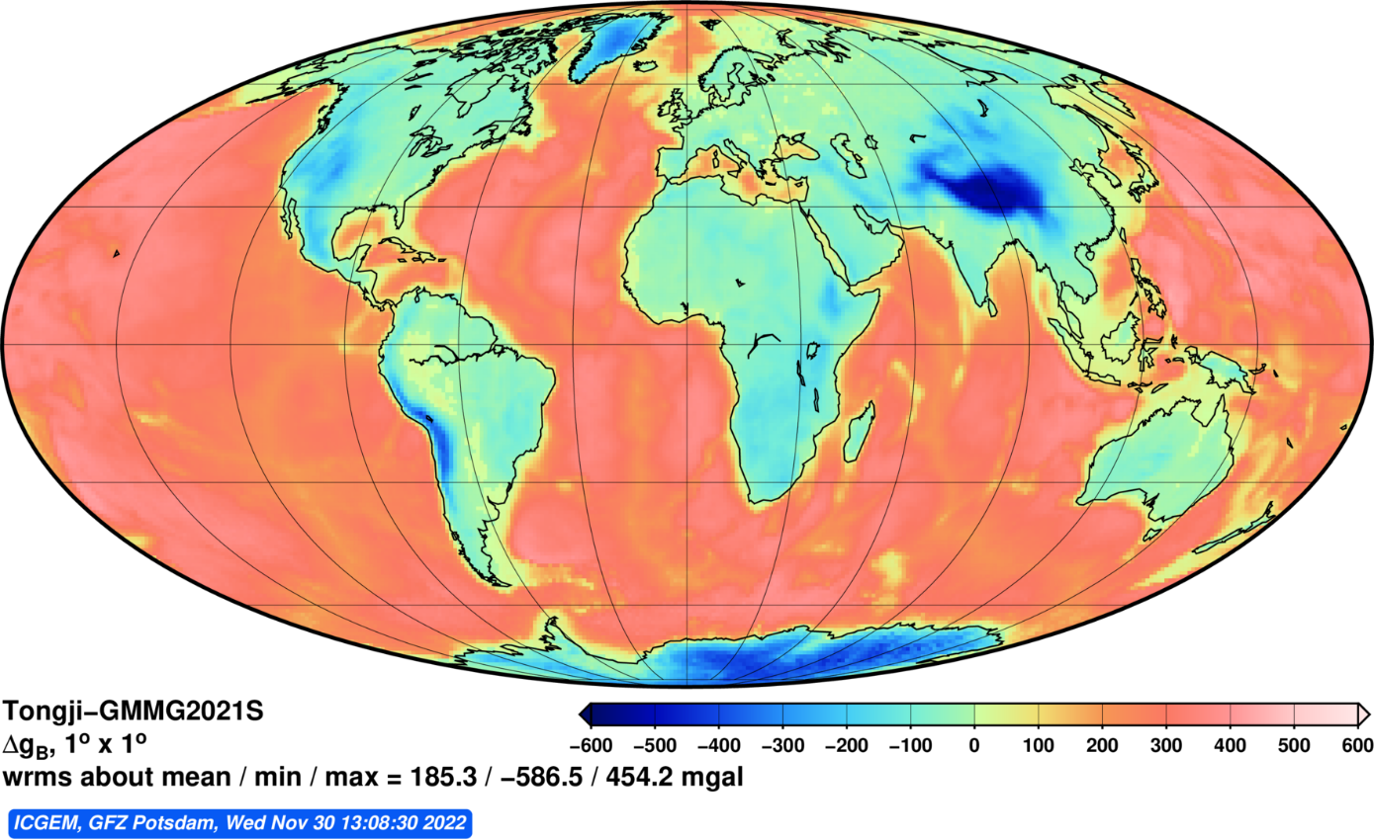

Geological properties and gravity
Bouguer Gravity

Slide 12
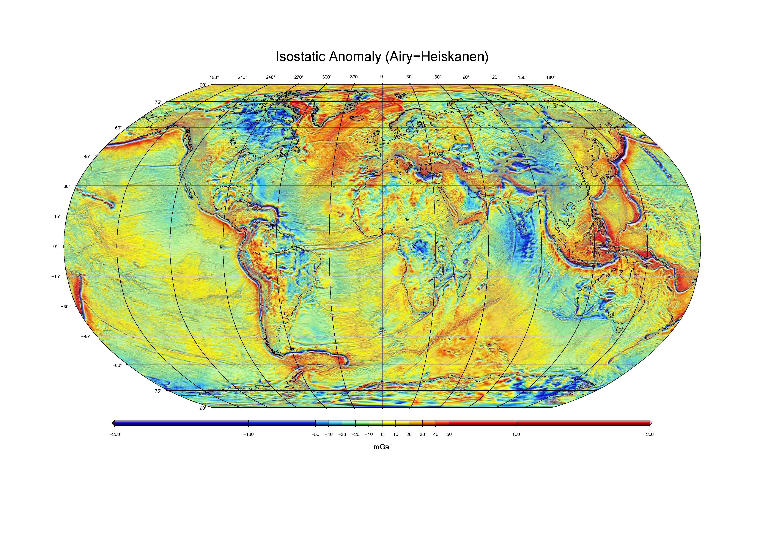
Geological properties and gravity
Residual Gravity
Bonvalot, S., Briais, A., Kuhn, M., Peyrefitte, A., Vales, N., Biancale, R., Gabalda, G., Moreaux, G., Reinquin, F. & Sarrailh, M. (2012). Global grids : World Gravity Map (WGM2012). Bureau Gravimetrique International. https://doi.org/10.18168/bgi.23

Slide 13
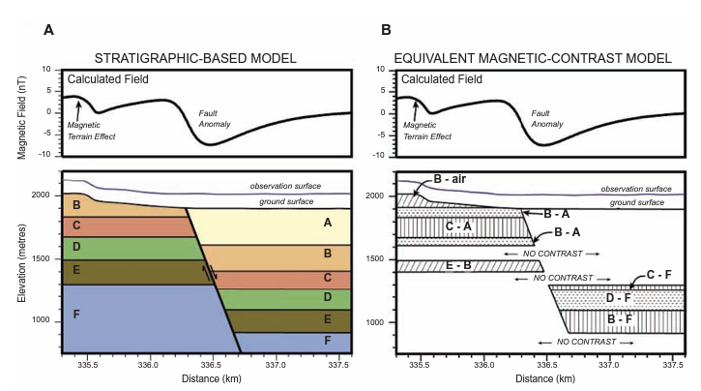
Geological properties and gravity
We detect contrasts
Isles & Rankin 2013
https://www.aseg.org.au/sites/default/files/ebook-ASEG-eBook-Geo-Interpretation-of-Aeromagnetic-Data-Opt-for-user-1621.pdf

Slide 14
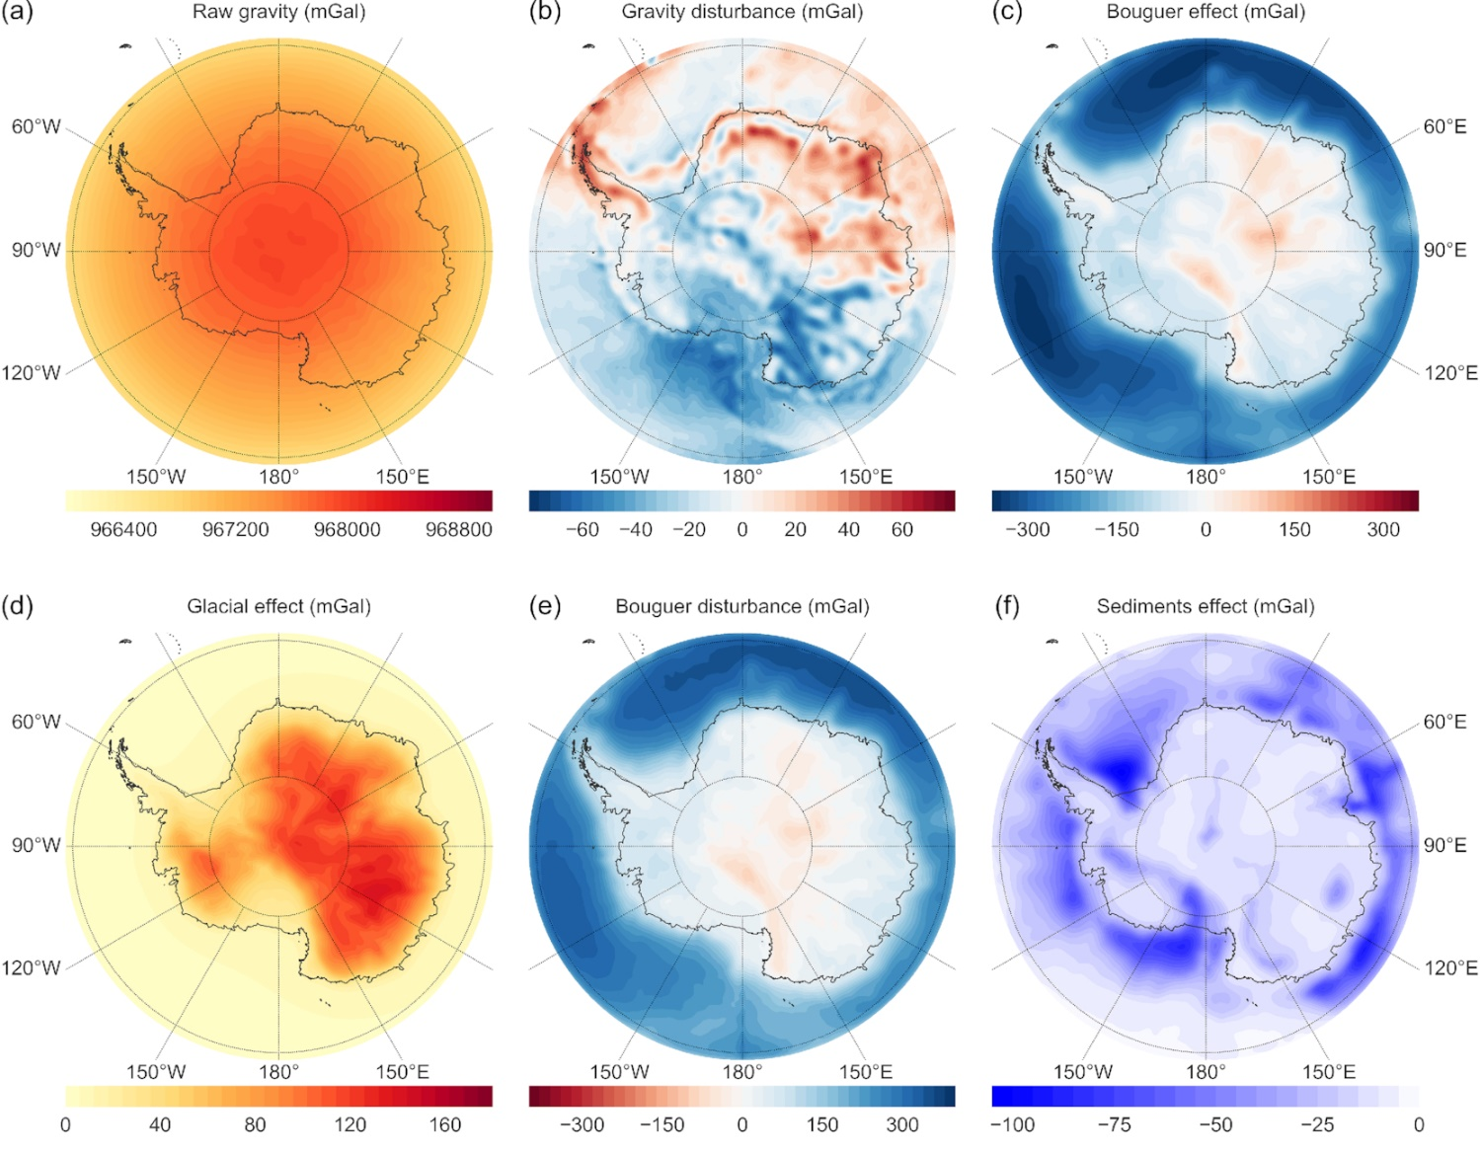
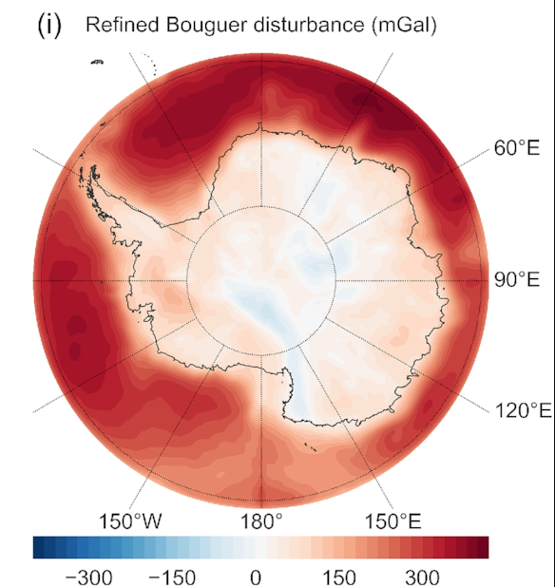
Gravity anomalies
Gravity effect of earth layers
Chisenga et al., 2019

Slide 15
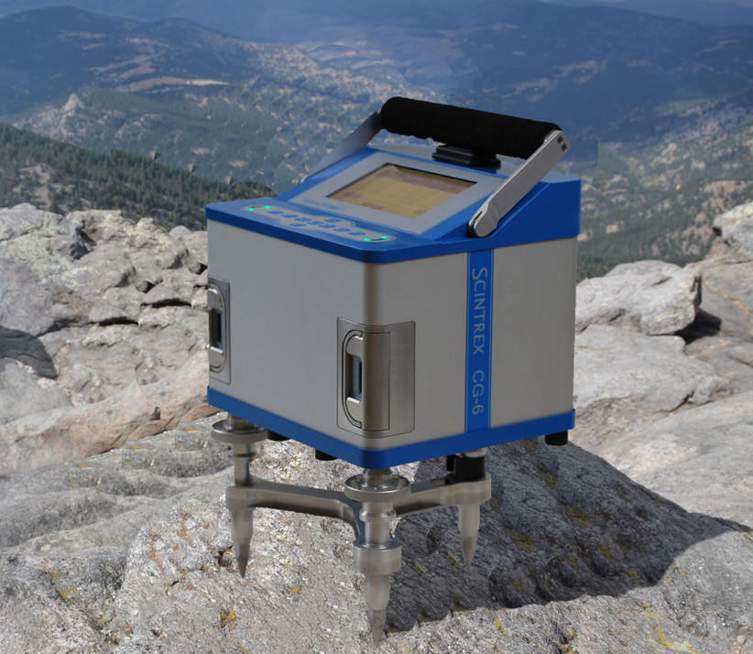
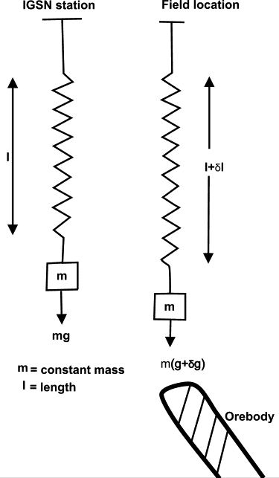
The gravimeter
CG6
Spring-based relative gravimeter
measures gravitational acceleration by detecting the displacement of a mass suspended on a spring
The displacement is proportional to the change in gravitational force
equipped with stabilizing system to reduce the effects of temperature changes and vibrations
Precision: ~0.1 microGal (0.1 μGal = 0.000001 m/s²)

Slide 16
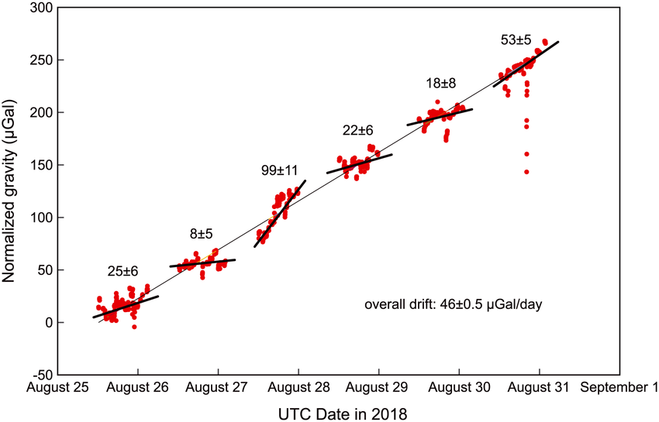
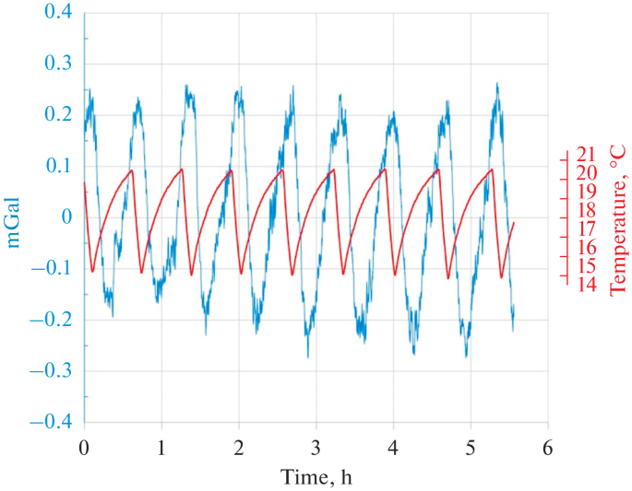
The gravimeter - Considerations
Poland et al., 2019
Instrument Drift:
Gradual changes in the instrument’s readings over time due to factors like mechanical wear or temperature variations.
Can affect accuracy and consistency of measurements.
Regular calibration and monitoring to detect and correct drift. Use of stable reference points for comparison.
Environmental Factors:
Temperature and humidity fluctuations can impact the sensitivity and stability of the gravimeter’s components.
External vibrations from machinery or natural sources can interfere with measurements.
Zheleznyak et al., 2022

Slide 17
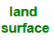
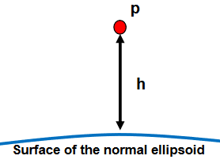
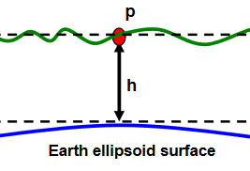
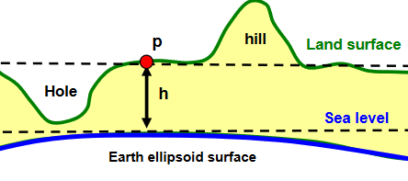
Gravity anomalies
1)
2)
Types of Gravity Anomalies:
Free-Air Anomaly/Disturbance: Corrects for elevation but not for the mass of terrain.
Bouguer Anomaly: Corrects for the gravitational effect of topography and provides insight into subsurface density variations.
Terrain Corrections: Adjust for local topography to refine Bouguer anomalies.
3)
Images: Introduction to Gravity Exploration method, Alsadi & Baban (2014)
Variations in the Earth's gravitational field caused by differences in subsurface density

Slide 18
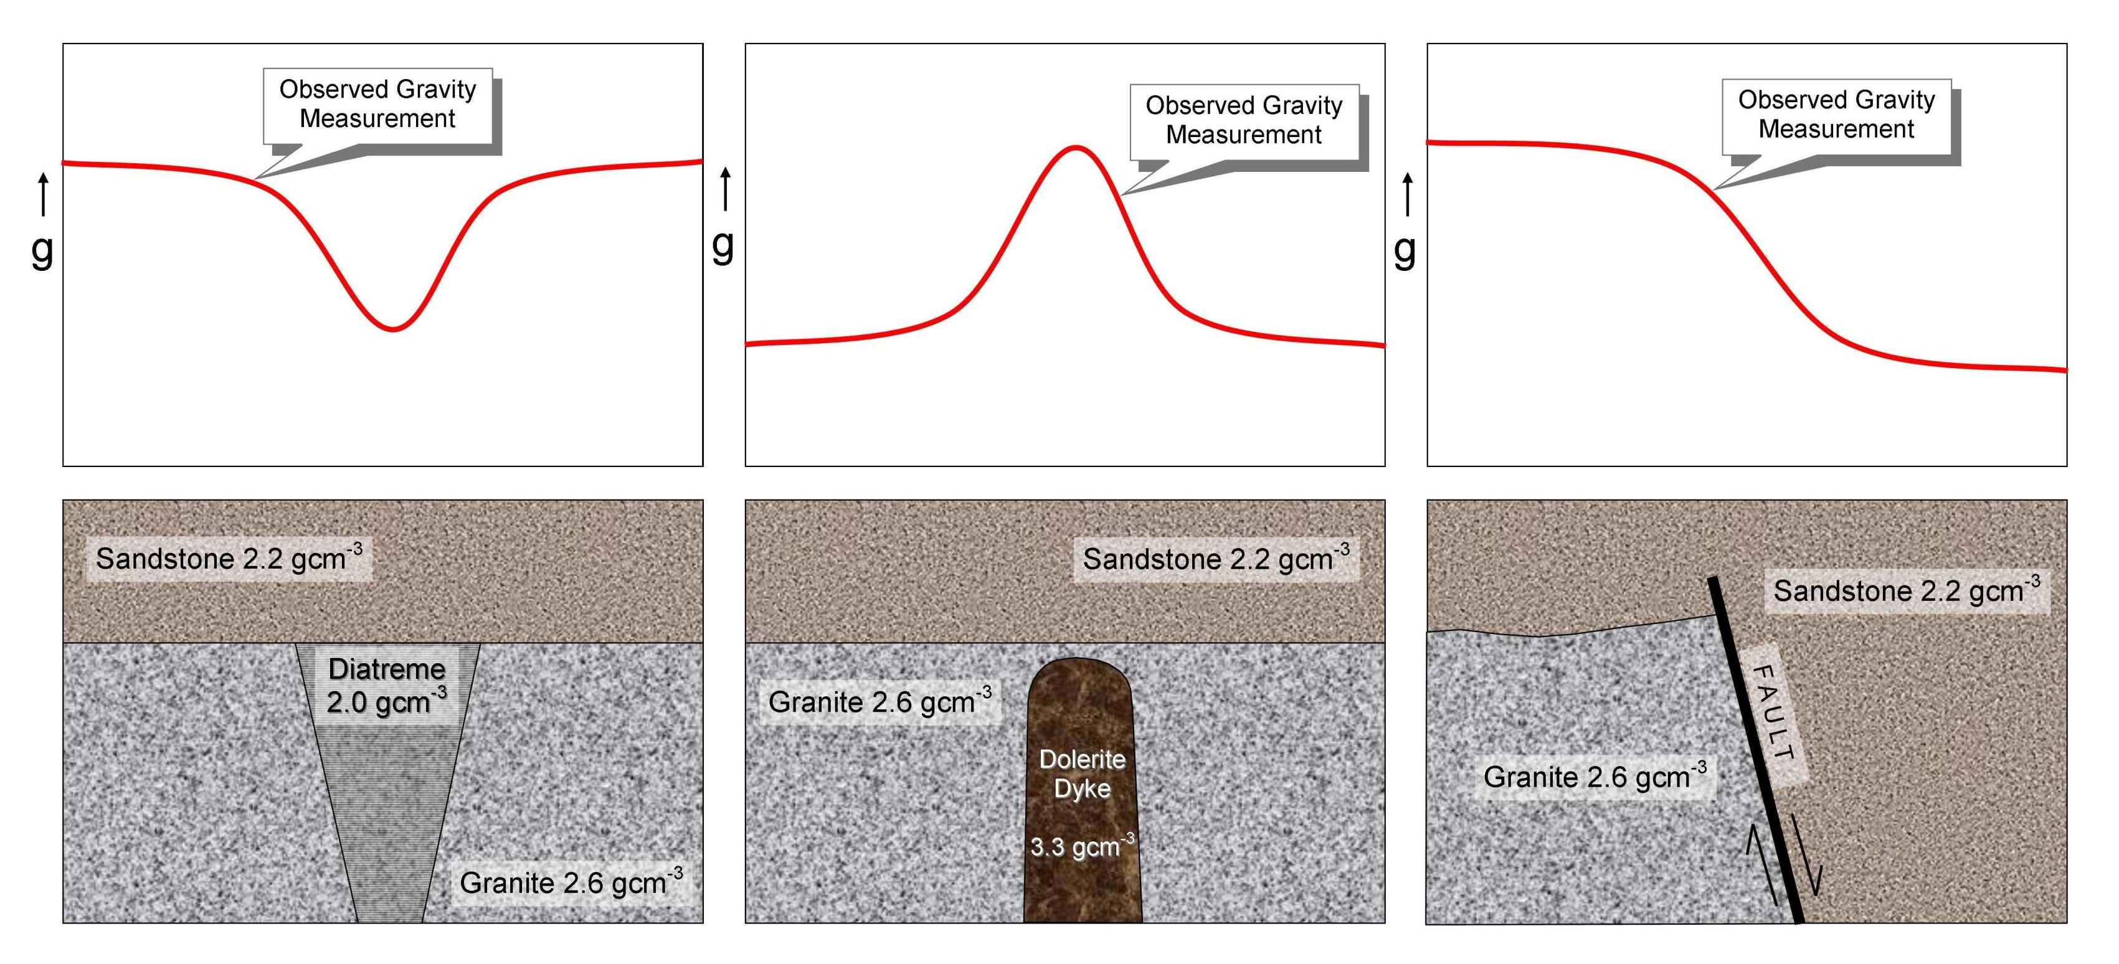
Gravity anomalies
Image: Geology for Investors, David Tilley

Slide 19
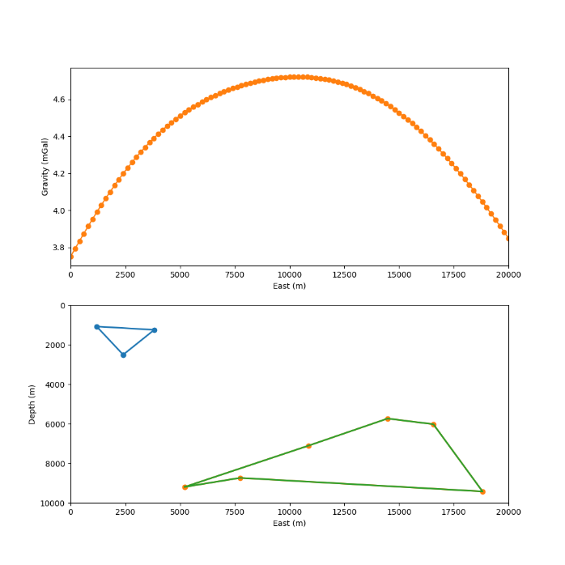
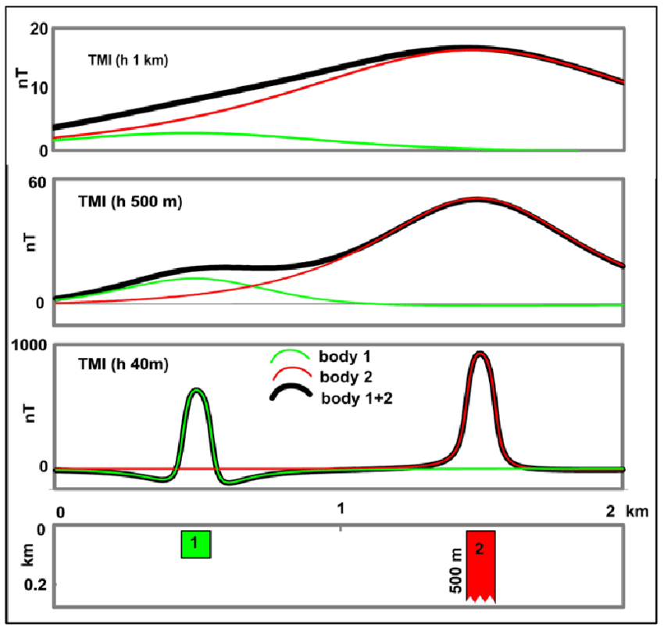
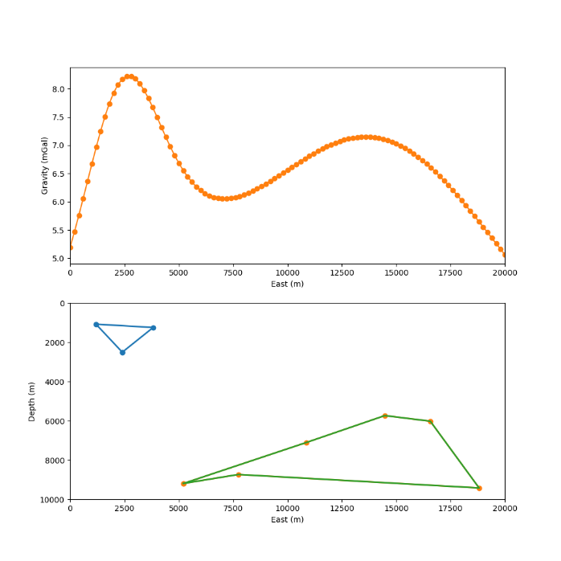
Gravity anomalies
Anomalies change with changing observation height
Flight height = 8 km
Flight height = 1 km
Isles & Rankin 2013
https://www.aseg.org.au/sites/default/files/ebook-ASEG-eBook-Geo-Interpretation-of-Aeromagnetic-Data-Opt-for-user-1621.pdf

Slide 20
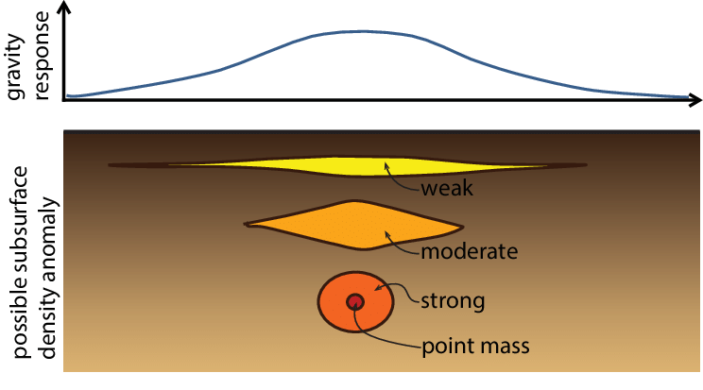
Non-Uniqueness
Multi-Method Approach: Integrating gravity data with other geophysical methods like magnetics, seismic, and electromagnetic surveys is important to get a comprehensive understanding of the subsurface.
Reducing Ambiguities: Combining different types of geophysical data helps reduce ambiguities in interpreting subsurface structures.
Image: UU Dept. of Earth Sciences

Slide 21

“Gravity” – movie poster, 2013

Slide 22
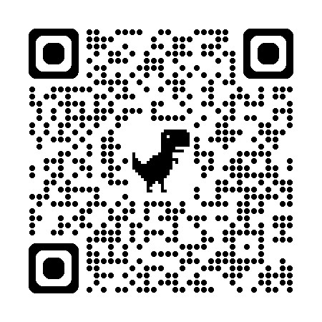




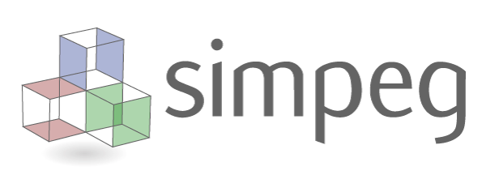
Code
Check out the Online Jupyter Notebooks:
https://github.com/LL-Geo/CAGE2024
https://mybinder.org/v2/gh/LL-Geo/CAGE2024/HEAD
Tutorial series from raw data to inversion
Raw_gravity_with_drift_correction
Normal_Gravity_correction
Topography_Correction
Data_Processing
Gravity inversion
Example series
example_point_source: Interactive notebook to See how gravity change with point source
example_2d_simpeg: run inversion for a 2d profile
example_sea_ice: real world example to get free air gravity in Antarctica
Fatiando a Terra

